Slide 1
PV239 – 02- Design
Roman Jašek, Michal Hazdra
Riganti s.r.o.
roman.jasek@riganti.cz
michal.hazdra@riganti.cz

Slide 2
Goals
Get to know available layouts and controls
Try to create a layout with some controls
Get to know available navigation options
Bonus:
- Styles
- Localization

Slide 3
Controls
Controls
Layouts
Navigation
Styles
Localization
ActivityIndicator
BoxView
Button
DatePicker
Editor
Entry
Image
Label
TimePicker
Slider
OpenGLView
Picker
ProgressBar
SearchBar
Stepper
WebView
TableView
ListView
TextCell
EntryCell
ImageCell
SwitchCell
ViewCell
Map
…

Slide 4
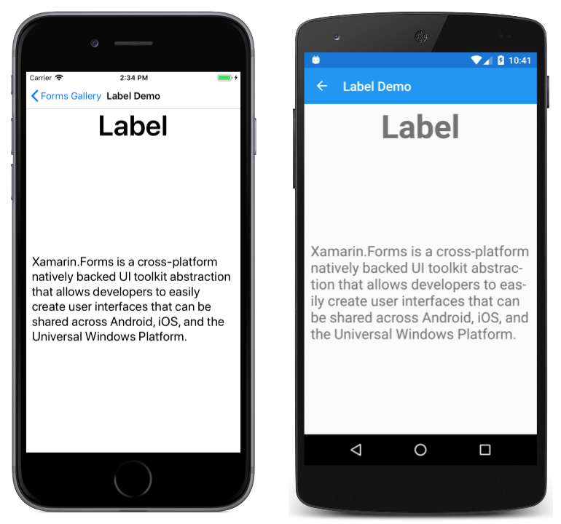
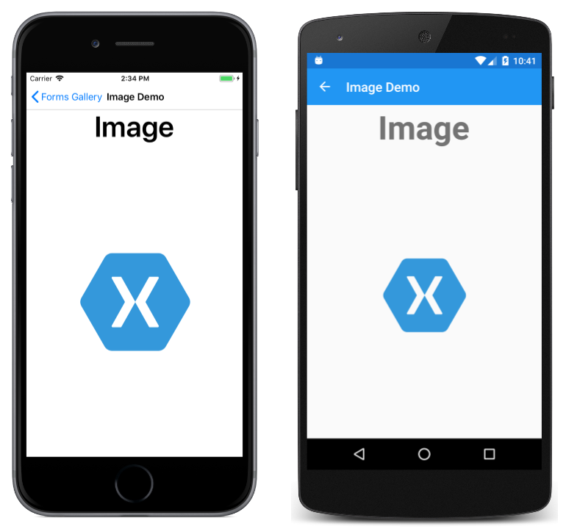
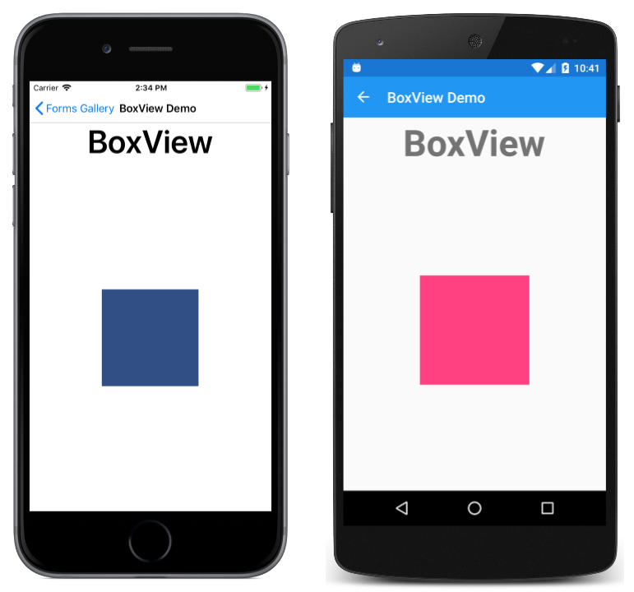
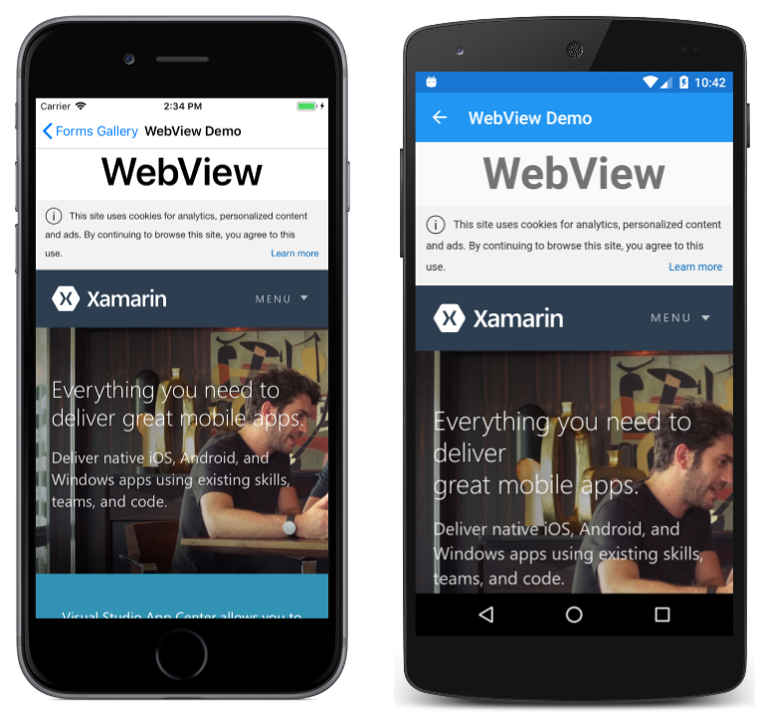
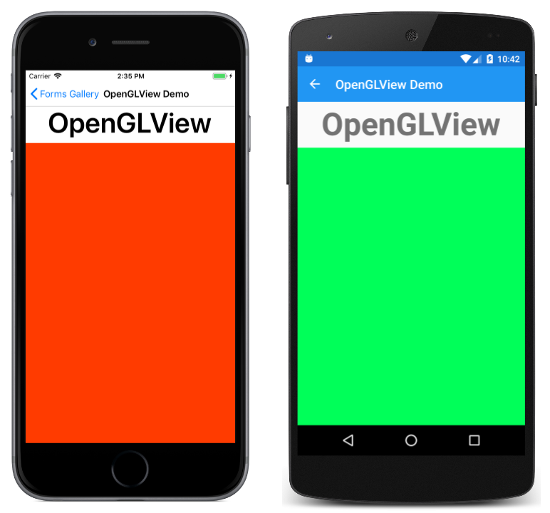
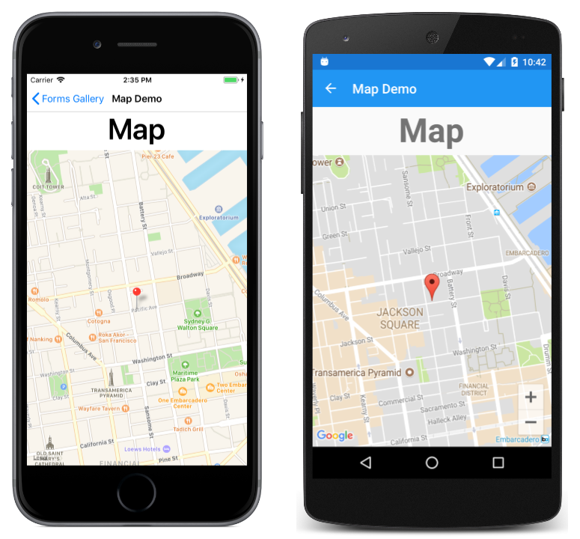
Content Presentation
Controls
Layouts
Navigation
Styles
Localization

Slide 5
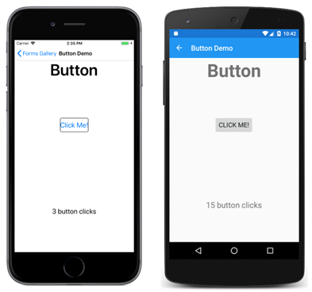
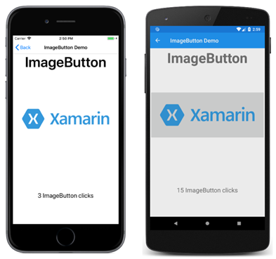
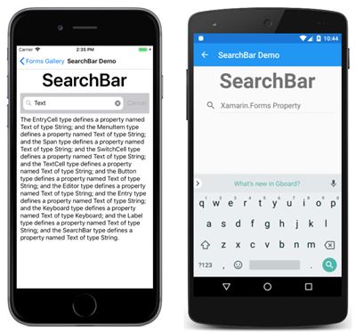
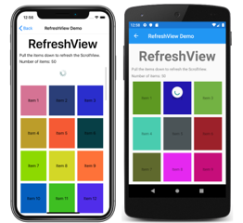
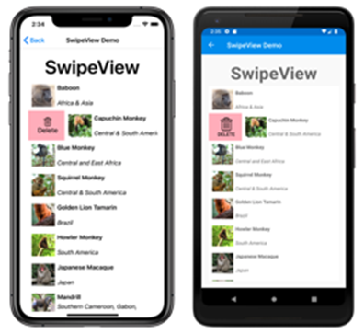
Actionable Controls
Controls
Layouts
Navigation
Styles
Localization

Slide 6
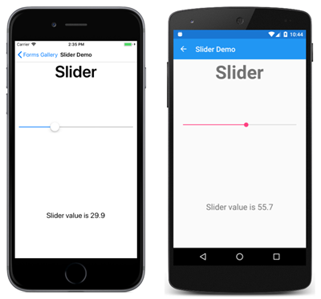
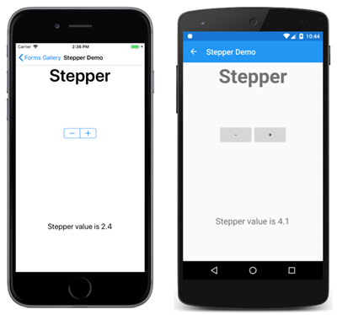

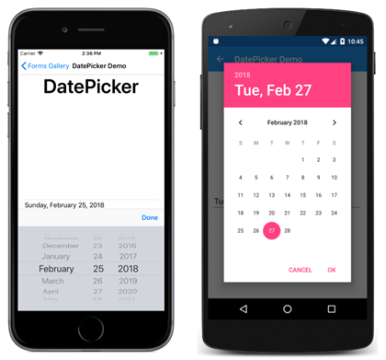
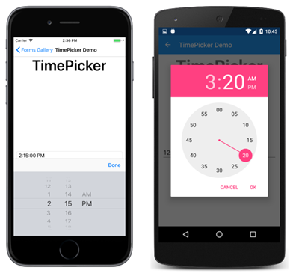
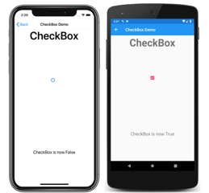
Setting Values
Controls
Layouts
Navigation
Styles
Localization

Slide 7
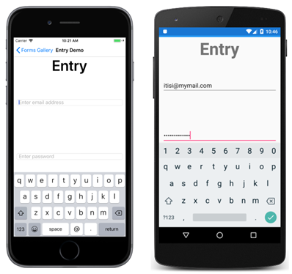
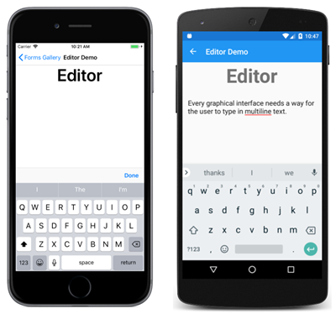
Editing Text
Controls
Layouts
Navigation
Styles
Localization

Slide 8
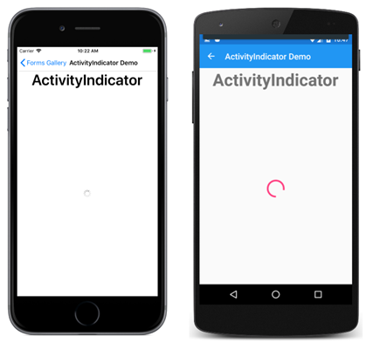
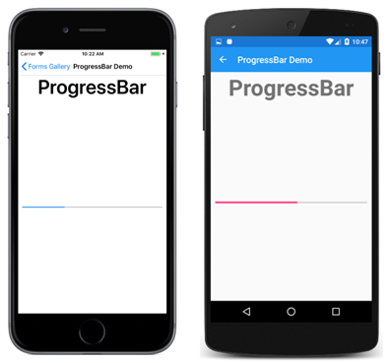
Activity Indication
Controls
Layouts
Navigation
Styles
Localization

Slide 9
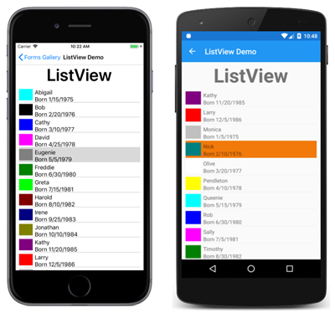
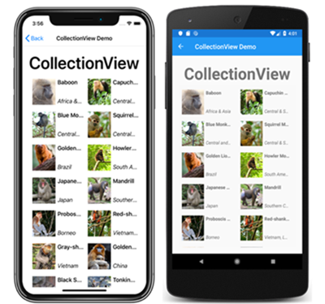
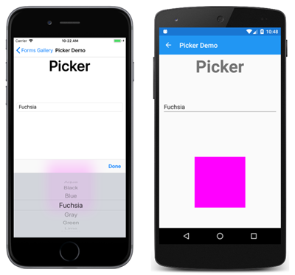
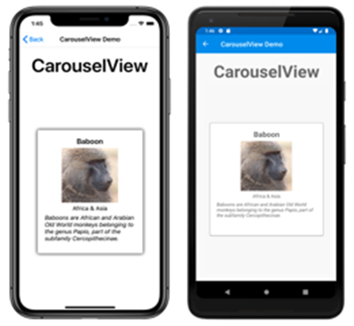
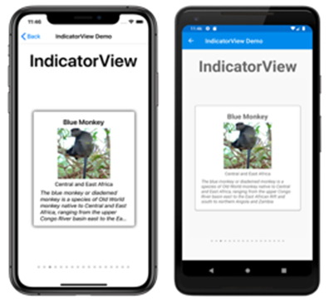
Collections
Controls
Layouts
Navigation
Styles
Localization

Slide 10
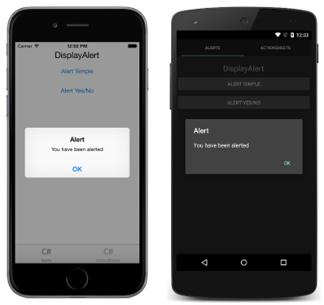
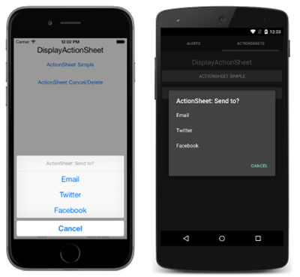
Pop-ups
Controls
Layouts
Navigation
Styles
Localization

Slide 11
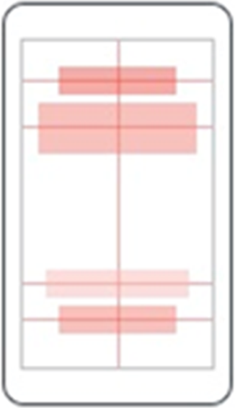
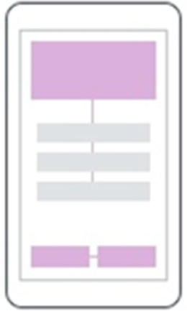
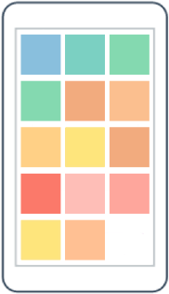
Layouts
Controls
Layouts
Navigation
Styles
Localization
AbsoluteLayout
RelativeLayout
FlexLayout

Slide 12
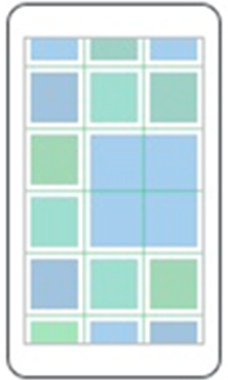
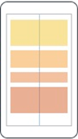
Layouts
Controls
Layouts
Navigation
Styles
Localization
Grid
StackLayout

Slide 13
Grid
Controls
Layouts
Navigation
Styles
Localization
Table-style layout
RowDefinitions, ColumnDefinitions
Width / Height = 150 | * | Auto
Grid.Row, Grid.Column – placement of control in the Grid
Grid.RowSpan, Grid.ColumnSpan – control can span over multiple “cells”
HorizontalSpacing, VerticalSpacing – empty space between “cells”

Slide 14
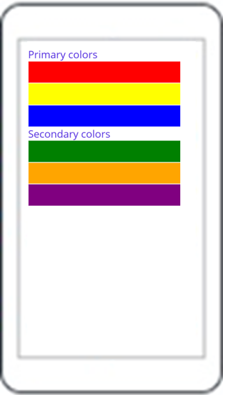
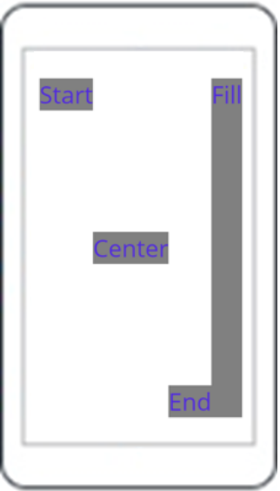
StackLayout
Controls
Layouts
Navigation
Styles
Localization
StackLayout
VerticalStackLayout
HorizontalStackLayout

Slide 15
StackLayout…
Controls
Layouts
Navigation
Styles
Localization
HorizontalStackLayout, VerticalStackLayout
Individual layouts for single direction
Separate LayoutManagers with Measure methods
Recommended (Performance)
StackLayout
Wraps HorizontalStackLayout and VerticalStackLayout
Has Orientation
Useful for adaptive layouts

Slide 16
Layouts
Controls
Layouts
Navigation
Styles
Localization
Demo

Slide 17

Layouts
Controls
Layouts
Navigation
Styles
Localization
Exercise

Slide 18
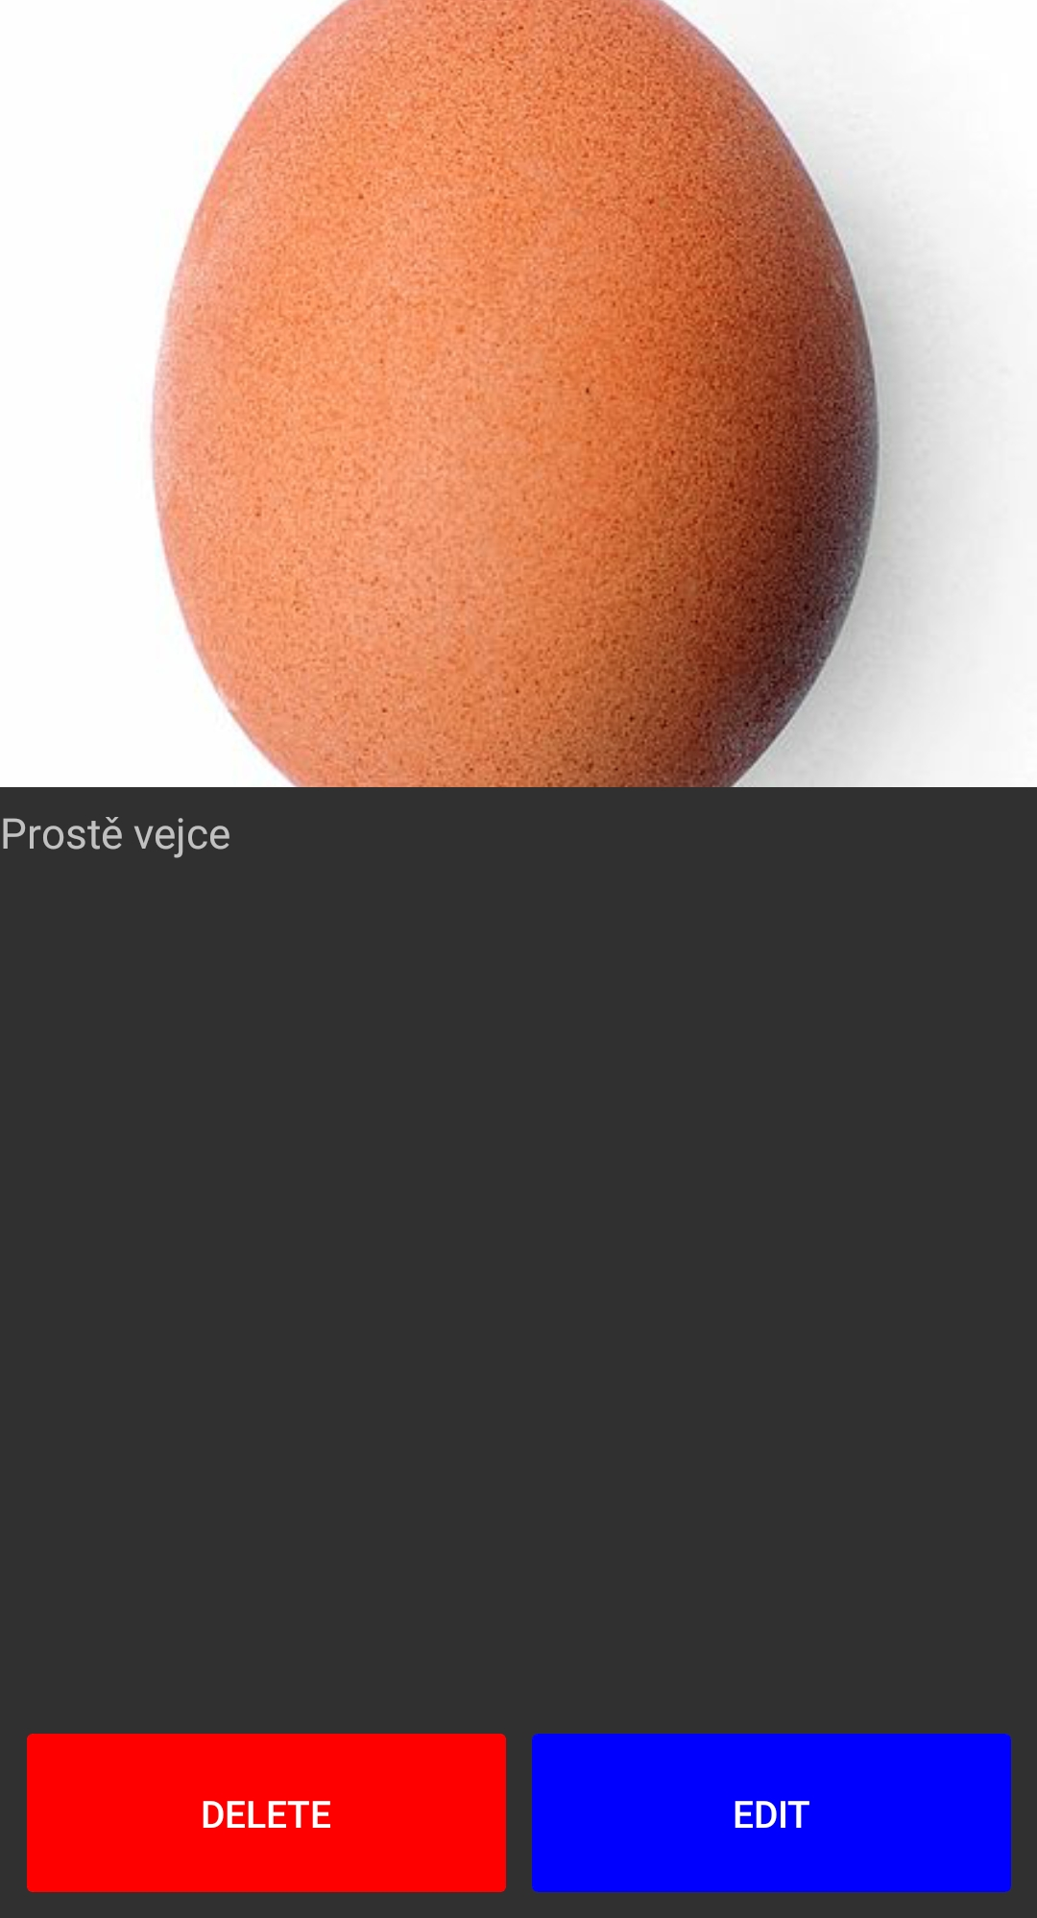
exercise - Layouts
Controls
Layouts
Navigation
Styles
Localization
Grid, Horizontal/VerticalStackLayout
Image, Label, Button

Slide 19
Resources
Controls
Layouts
Navigation
Styles
Localization
Each element contains a collection of Resources
Resources can define any content
Referencing using x:Key
Access with {StaticResource Key}
Can be defined in separate files - merged dictionaries
Hierarchical application
Can be overridden on any level

Slide 20
Styles
Controls
Layouts
Navigation
Styles
Localization
Settign style for a control
TargetType – specifies which element type it should be applied to
x:Key – key of style, can be omitted – in that case it will be automatically applied to all controls of the type
Collection of Setter objects
Property
Value
BasedOn – base style that this style extends – optional

Slide 21
Styles
Controls
Layouts
Navigation
Styles
Localization
Demo

Slide 22
Goals
Get to know available layouts and controls
Try to create a layout with some controls
Get to know available navigation options
Bonus:
- Styles
- Localization

Slide 23


